Slide 1

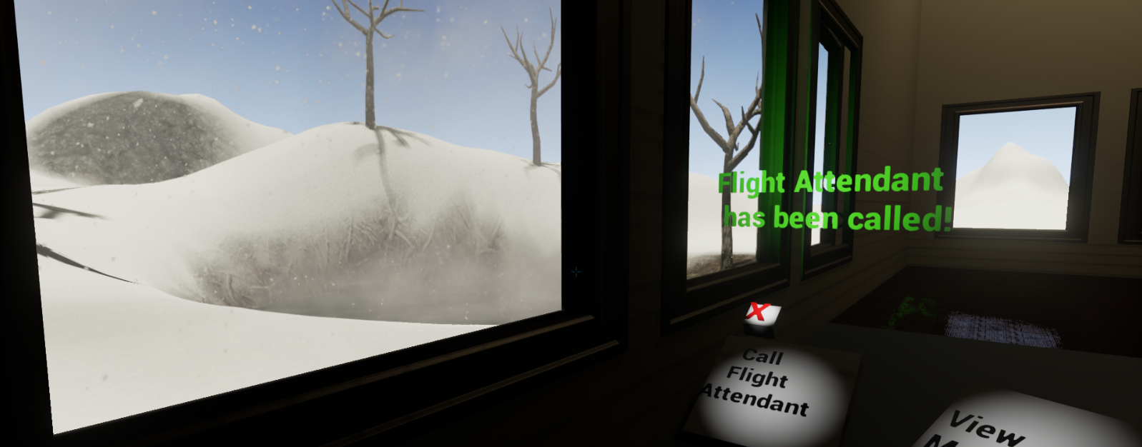
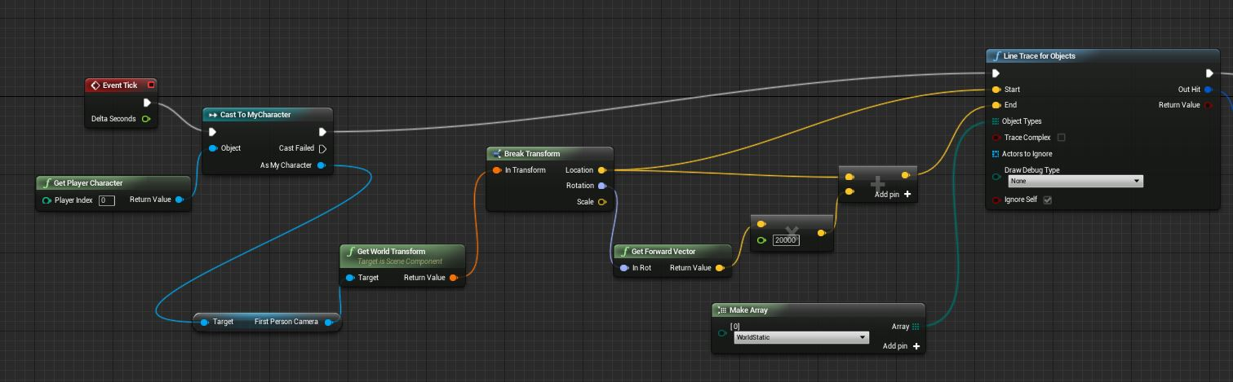


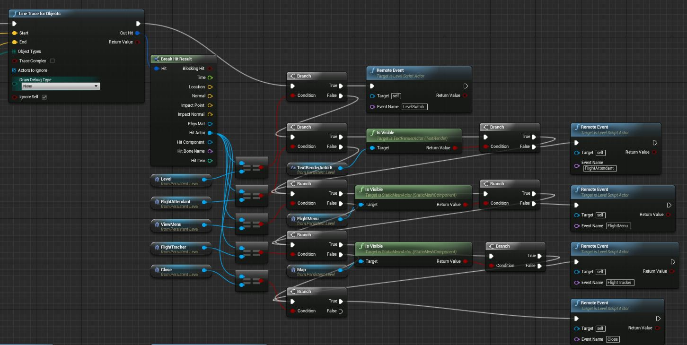
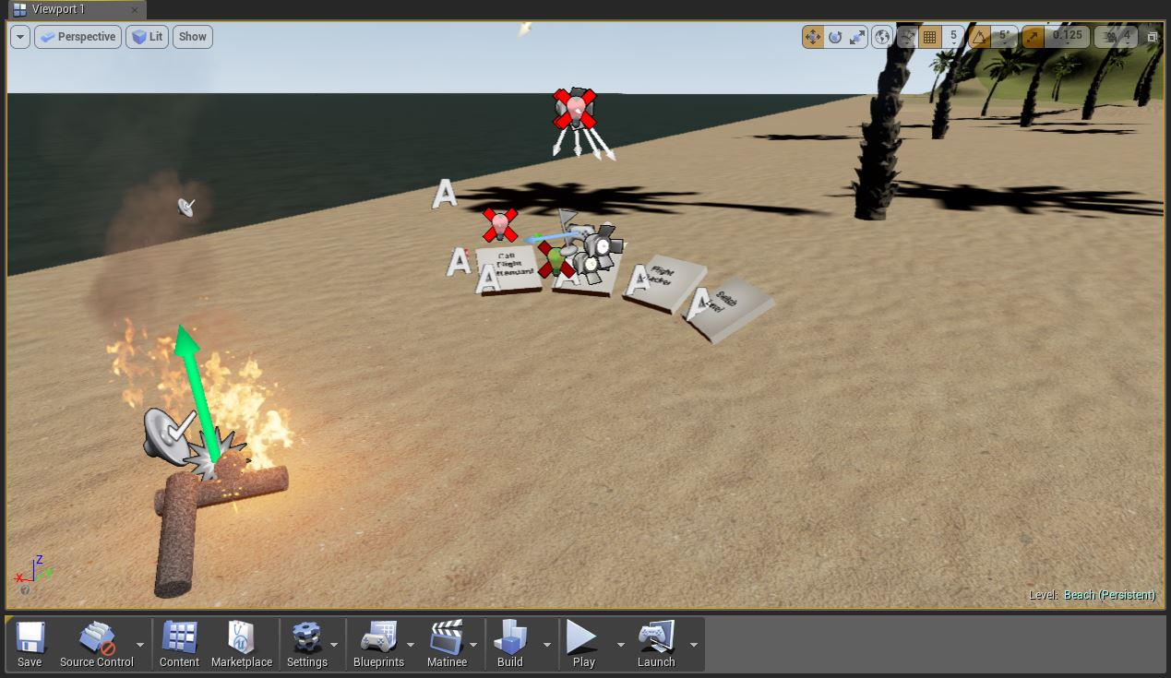
Boeing Virtual Reality
Luke Holbert, Brett Johnson, Conor Devitt, and Taylor Winslow
Project Overview
Current Prototype Features
Future Features
Our team is a part of the WSU Boeing Scholars program. Our project goal was to create a virtual reality program that could be used on an airplane to enhance passenger safety and comfort. Our efforts have been focused on creating a software prototype using Unreal Engine 4. The purpose of this program is to have a few relaxing environments that can take the user’s mind off the flight, as well as display flight information within these environments in an intuitive manner. The current version of our program allows the user to toggle a flight attendant call, view the in-flight menu, see a flight tracker, and switch environments simply by looking at their corresponding in-environment objects. A live demo using the Oculus Rift is currently set up so you can see our prototype in action.
Three interchangeable environments that are aesthetically different but functionally identical: a sunny environment, a rainy environment, and a snowy environment all complete with a day-night cycle and realistic weather and sound effects
Flight attendant call, in-flight menu, and flight path options can be selected by simply looking at the corresponding in-environment object
The user is able to view each of the aforementioned pieces of information three-dimensionally within the environment itself
Program does not crash with any combination of user input
Early on before the development stage of our product, we had to decide what we could reasonably accomplish before the end of the year. Because of this, there were numerous ideas we had for the future of this project that we were not able to implement. Some would be implemented in a similar manner to the functions that already exist, and others would be different programs entirely. Some of these features are listed here:
Bathroom occupancy notifications and status indicator
In-flight notifications displayed within the environment
Virtual tours of the user’s destination
Integrating entertainment into the device (music, movies, etc.)
Virtual reality safety demonstration
We believe the ultimate selling point of airline virtual reality would be a virtual tour of the sky, something that gives you the feeling of true flight. With cameras mounted on the exterior of the plane, we could get a live feed of your surroundings, patch the images together and give the user a 360-degree view of their surroundings, sans-plane.
Turning this…. Into this.
Menu Design Process
In each level blueprint, an event tick was set up to track the player camera vector and see which object it is currently colliding with. This essentially acts as a line-of-sight trigger. This blueprint can be seen below.
Development History and Environments
Development began in November of 2014, when we decided to use Unity 4 to build our first prototype, a simple beach environment. Shortly after this was completed, the decision was made to switch to Unreal Engine 4 for the rest of our development process. We started by recreating our first beach environment, then proceeded to build our snowy and rainy environments. The snowy and rainy environments are very similar, both shaped around the same simple house. All assets used in these environments came stock with Unreal Engine 4. After the environment were completed, work began on implementing our menus and features.
If the line trace returns one of the objects that we want to look for, it triggers a specific remote event for that object. Each event is different, but other than the level switch, they all simply make their corresponding menu and spotlight visible, and the others invisible, after a short delay. The blueprint section that does these checks for the looked at object is seen below. The remote events are the only part of the menu implementation not shown here.
Hardware Implementation
While our team mainly focused on creating software for VR headsets that could be used on an airplane, some thought was also put into the hardware implementation as well. The main hurdle for this is that our program and most other virtual reality software requires a fairly powerful computer to get reasonable performance, in particular a mid to high-end GPU. Whatever the most efficient solution to this problem may be, it would probably have to be located under the floor. The cabling would then be run up though the users chair leading to a port near the top of the chair. This is where the headset would be plugged into. While our hardware progress has been limited in comparison to our software development thus far, we plan on taking significant steps forward in the near future.

